Slide 1
Machine Learning Slides
Part 2 – Unsupervised Learning

Slide 2
Unsupervised Learning
Covers 3 main areas:
Clustering
Hard
Soft
Dimensionality reduction
Matrix factorization – SVD, PCA, NNMF, etc
Association Rules Mining
Shopping Basket Analysis
e.g. Amazon – items commonly purchased together
Apriori
Eclat

Slide 3
Clustering
Using a similarity function, can we group our data into distinct clusters?
Algorithms:
Kmeans
DBScan – density based
Affinity Propagation (graph-based clustering)

Slide 4
K-Means
Users specifies k – number of clusters used to group the data
Pick k points from the dataset at random -> initial cluster centers
Assign the remaining data points to the cluster with the nearest cluster center (based on some similarity function)
Compute the average point for each cluster -> new cluster center
Repeat 2,3 until no points move between clusters

Slide 5
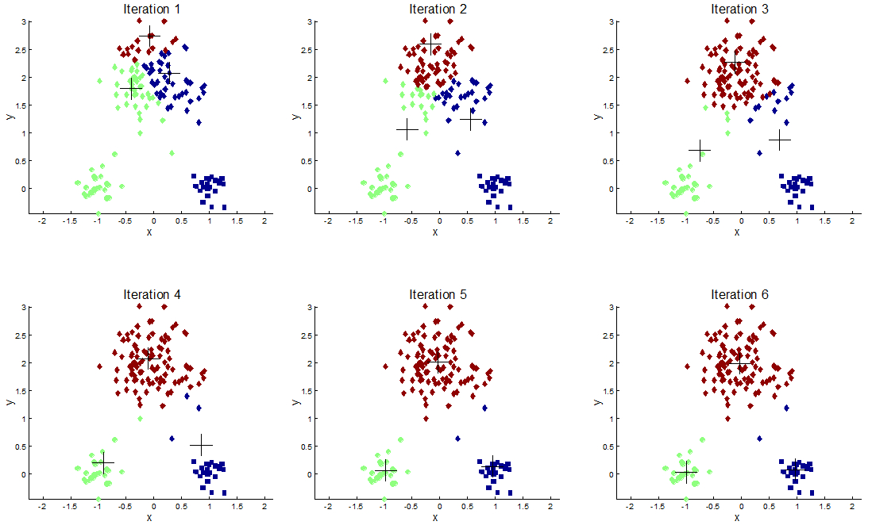
K-Means

Slide 6
Unsupervised Learning Algorithm Template – Some Changes
Prediction Accuracy on New Data
Performance at Scale
Parallelizable?
Interpretability
Bias / Variance Limitations
What type of data can it handle?
Can it learn effectively from high dimensional data?
Simplicity (ease of use \ configuration)

Slide 7
Characteristics of K-Means
Performance at Scale
Parallelizable?
Interpretability
Limitations
What type of data can it handle?
Can it learn effectively from high dimensional data?
Simplicity (ease of use \ configuration)

Slide 8
Characteristics of K-Means
Performance at Scale
Fast to assign a new data point to a cluster once trained. However, clustering is iterative, requires computing the distance between all pairs of points, and needs repeated runs to get the best clusters.
Parallelizable?
Interpretability
Limitations
What type of data can it handle?
Can it learn effectively from high dimensional data?
Simplicity (ease of use \ configuration)

Slide 9
Characteristics of K-Means
Performance at Scale
Fast to assign a new data point to a cluster once trained. However, clustering is iterative, requires computing the distance between all pairs of points, and needs repeated runs to get the best clusters.
Parallelizable?
Can be easily parallelized – compute similarities in parallel, assign to clusters in parallel
Interpretability
Limitations
What type of data can it handle?
Can it learn effectively from high dimensional data?
Simplicity (ease of use \ configuration)

Slide 10
Characteristics of K-Means
Performance at Scale
Fast to assign a new data point to a cluster once trained. However, clustering is iterative, requires computing the distance between all pairs of points, and needs repeated runs to get the best clusters.
Parallelizable?
Can be easily parallelized – compute similarities in parallel, assign to clusters in parallel
Interpretability
A clustering algorithms, the clusters can be interpreted by similarity
Limitations
What type of data can it handle?
Can it learn effectively from high dimensional data?
Simplicity (ease of use \ configuration)

Slide 11
Characteristics of K-Means
Performance at Scale
Fast to assign a new data point to a cluster once trained. However, clustering is iterative, requires computing the distance between all pairs of points, and needs repeated runs to get the best clusters.
Parallelizable?
Can be easily parallelized – compute similarities in parallel, assign to clusters in parallel
Interpretability
A clustering algorithms, the clusters can be interpreted by similarity
Limitations
Sensitive to random initialization – needs multiple runs to get the best results
Cannot learn non globular clusters (ones that’s aren’t round)
What type of data can it handle?
Can it learn effectively from high dimensional data?
Simplicity (ease of use \ configuration)

Slide 12
Characteristics of K-Means
Performance at Scale
Fast to assign a new data point to a cluster once trained. However, clustering is iterative, requires computing the distance between all pairs of points, and needs repeated runs to get the best clusters.
Parallelizable?
Can be easily parallelized – compute similarities in parallel, assign to clusters in parallel
Interpretability
A clustering algorithms, the clusters can be interpreted by similarity
Limitations
Sensitive to random initialization – needs multiple runs to get the best results
Cannot learn non globular clusters (ones that’s aren’t round)
What type of data can it handle?
No output, inputs can be continuous and nominal, need an appropriate similarity metric
Can it learn effectively from high dimensional data?
Simplicity (ease of use \ configuration)

Slide 13
Characteristics of K-Means
Performance at Scale
Fast to assign a new data point to a cluster once trained. However, clustering is iterative, requires computing the distance between all pairs of points, and needs repeated runs to get the best clusters.
Parallelizable?
Can be easily parallelized – compute similarities in parallel, assign to clusters in parallel
Interpretability
A clustering algorithms, the clusters can be interpreted by similarity
Limitations
Sensitive to random initialization – needs multiple runs to get the best results
Cannot learn non globular clusters (ones that’s aren’t round)
What type of data can it handle?
No output, inputs can be continuous and nominal, need an appropriate similarity metric
Can it learn effectively from high dimensional data?
Same limitations as k-nn here. As the number of dimensions grows, distances between points converge
Simplicity (ease of use \ configuration)

Slide 14
Characteristics of K-Means
Performance at Scale
Fast to assign a new data point to a cluster once trained. However, clustering is iterative, requires computing the distance between all pairs of points, and needs repeated runs to get the best clusters.
Parallelizable?
Can be easily parallelized – compute similarities in parallel, assign to clusters in parallel
Interpretability
A clustering algorithms, the clusters can be interpreted by similarity
Limitations
Sensitive to random initialization – needs multiple runs to get the best results
Cannot learn non globular clusters (ones that’s aren’t round)
What type of data can it handle?
No output, inputs can be continuous and nominal, need an appropriate similarity metric
Can it learn effectively from high dimensional data?
Same limitations as k-nn here. As the number of dimensions grows, distances between points converge
Simplicity (ease of use \ configuration)
One key parameter – k
However, does not learn the number of clusters itself, so some trial and error required, will not exclude outliers

Slide 15
K-Means - Limitations
Sensitive to initialization – often re-run many times and take the ‘best’ cluster output, according to some metric
Similarity based and iterative – doesn’t scale well
Hard clusters – does not discover the number of clusters
Can only handle globular clusters – clusters that have more complex shapes will not be handled well

Slide 16
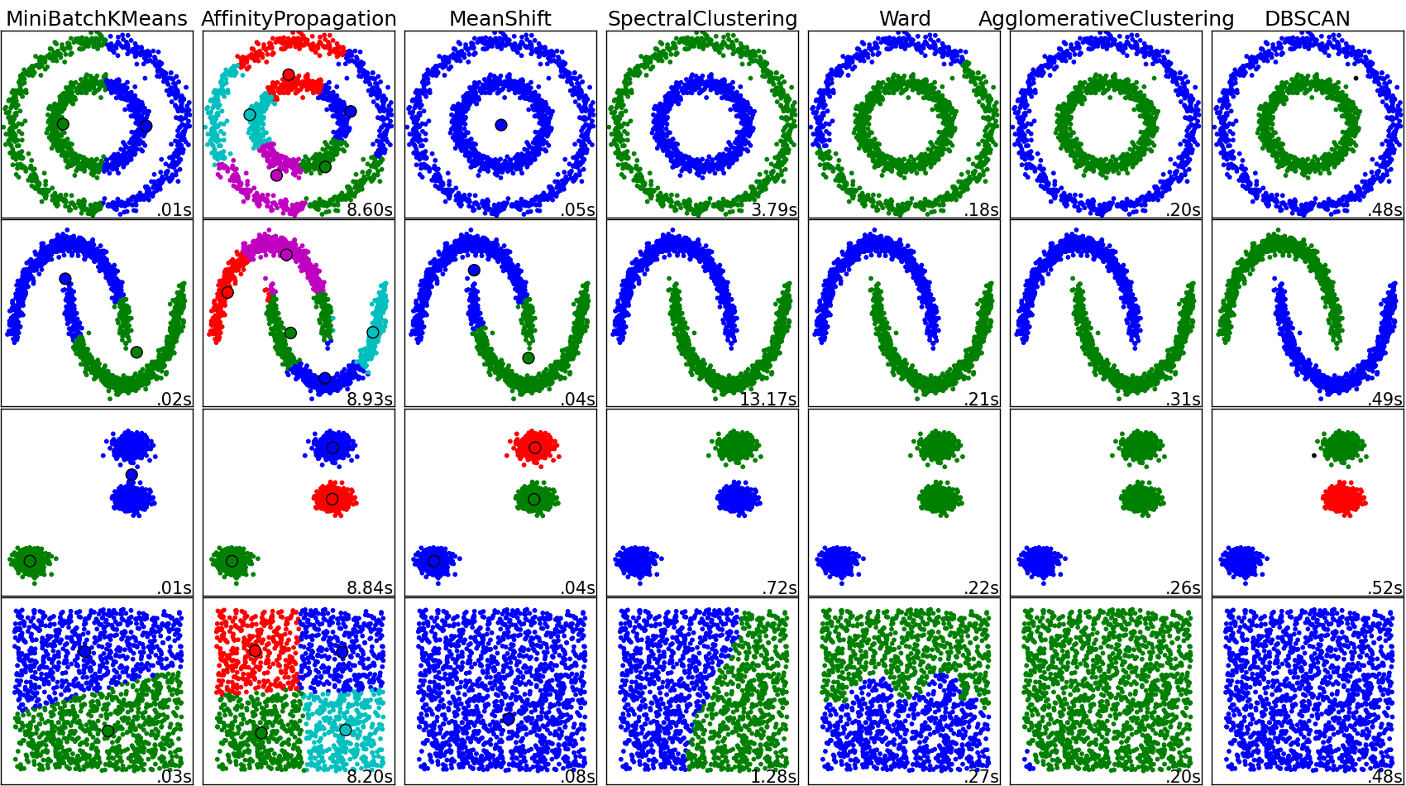
Other Clustering Algorithms

Slide 17
Dimensionality Reduction
Find a low rank approximation of some data set
Reduce the number of columns \ features
New features are learned from the data that represent multiple features from the original dataset
A form of data compression
Some of the same algorithms used for image compression
Used when the number of features is too large to train a model within an acceptable timeframe
Common in NLP
Large number of features - one feature per word in dataset in a bag of words representation
Can remove noise from the data
Can be thought of as a form of soft clustering
Each value for each new dimension represents partial membership of that cluster
Algorithms
Truncated SVD, NNMF, PCA
Supervised dimensionality reduction also exists, e.g. Linear Discriminants Analysis

Slide 18
PCA – A Dimensionality Reduction Algorithm
For a p dimensional dataset, learn p new dimensions that are uncorrelated (orthogonal)
Pick the k new dimensions that capture the most variance in the data – principal components
This new k dimensional matrix captures the maximum variance from the original dataset in k dimensions
The original matrix can be reconstructed from the k-dimensional representation by matrix multiplication
The algorithm learns a linear transformation over the data such that the reconstruction error is minimized

Slide 19
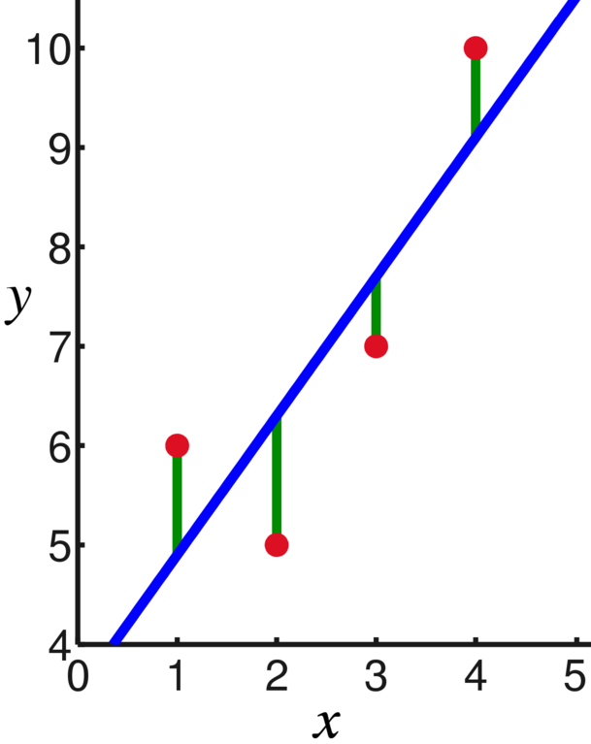
Remember This?

Slide 20
Linear Regression – Least Squares Fit

Slide 21
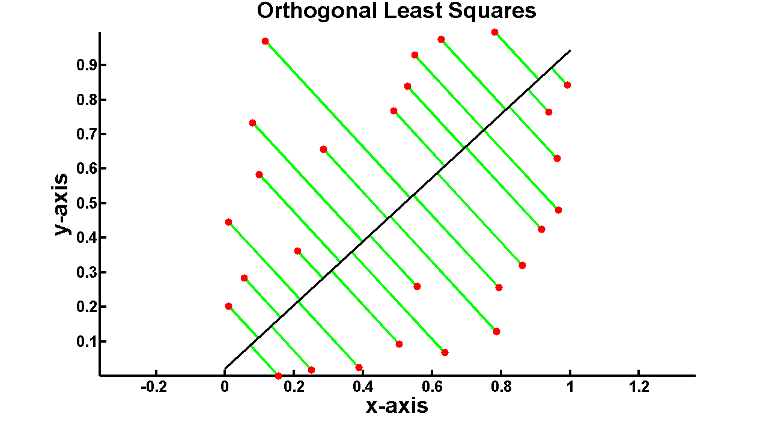
PCA - Orthogonal Least Squares

Slide 22
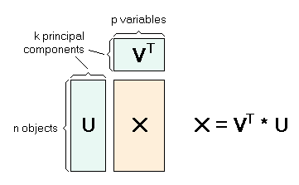
PCA - Matrix Factorization

Slide 23

Denoising
Notes:
From http://students.ou.edu/B/Nafise.Barzigar-1/software/DMC.html - last visited 10.18.2014

Slide 24
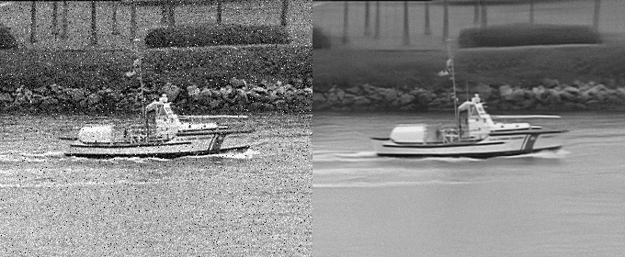
Denoising
Notes:
From http://students.ou.edu/B/Nafise.Barzigar-1/software/DMC.html - last visited 10.18.2014

Slide 25
Characteristics of PCA
Performance at Scale
Parallelizable?
Interpretability
Limitations
What type of data can it handle?
Can it learn effectively from high dimensional data?
Simplicity (ease of use \ configuration)

Slide 26
Characteristics of PCA
Performance at Scale
Matrix factorization is very slow, requires a lot of RAM
Parallelizable?
Interpretability
Limitations
What type of data can it handle?
Can it learn effectively from high dimensional data?
Simplicity (ease of use \ configuration)

Slide 27
Characteristics of PCA
Performance at Scale
Matrix factorization is very slow, requires a lot of RAM
Parallelizable?
Yes, because matrix multiplication can be parallelized
Interpretability
Hard. Can plot top 2 components. But outputs a bunch a numbers
Limitations
What type of data can it handle?
Can it learn effectively from high dimensional data?
Simplicity (ease of use \ configuration)

Slide 28
Characteristics of PCA
Performance at Scale
Matrix factorization is very slow, requires a lot of RAM
Parallelizable?
Yes, because matrix multiplication can be parallelized
Interpretability
Hard. Can plot top 2 components. But outputs a bunch a numbers
Limitations
Can only learn linear transformations. Hidden structure in the data may not be linear
What type of data can it handle?
Can it learn effectively from high dimensional data?
Simplicity (ease of use \ configuration)

Slide 29
Characteristics of PCA
Performance at Scale
Matrix factorization is very slow, requires a lot of RAM.
Can take advantage of sparsity
Parallelizable?
Yes, because matrix multiplication can be parallelized
Interpretability
Hard. Can plot top 2 components. But outputs a bunch a numbers
Limitations
Can only learn linear transformations. Hidden structure in the data may not be linear
What type of data can it handle?
Data needs to be converted to numeric form.
Can it learn effectively from high dimensional data?
Simplicity (ease of use \ configuration)

Slide 30
Characteristics of PCA
Performance at Scale
Matrix factorization is very slow, requires a lot of RAM.
Can take advantage of sparsity
Parallelizable?
Yes, because matrix multpilication can be parallelized
Interpretability
Hard. Can plot top 2 components. But outputs a bunch a numbers
Limitations
Can only learn linear transformations. Hidden structure in the data may not be linear
What type of data can it handle?
Data needs to be converted to numeric form.
Can it learn effectively from high dimensional data?
Extracts the data points that most explain variation in the data. So yes, provided it can be computed due to performance constraints
Simplicity (ease of use \ configuration)

Slide 31
Characteristics of PCA
Performance at Scale
Matrix factorization is very slow, requires a lot of RAM.
Can take advantage of sparsity
Parallelizable?
Yes, because matrix multiplication can be parallelized
Interpretability
Hard. Can plot top 2 components. But outputs a bunch a numbers
Limitations
Can only learn linear transformations. Hidden structure in the data may not be linear
What type of data can it handle?
Data needs to be converted to numeric form.
Can it learn effectively from high dimensional data?
Extracts the data points that most explain variation in the data. So yes, provided it can be computed due to performance constraints
Simplicity (ease of use \ configuration)
Only parameter is the number of principal components

Slide 32
Association Rules
Market Basket Analysis
Looks for items that commonly occur together
E.g. {butter, milk} => {bread}
E.g. {onions, potatoes, bread bun} => {burger}
This is very useful for Pattern Discovery
Discovering regularities in product purchase patterns in point of sales systems. This can aid marketing decisions, such as product placements, promotional pricing
Intrusion detection
Bioinformatics (such as gene analysis)
Terminology:
Deals with transactions
Each transaction is a set of items (an itemset)

Slide 33
Apriori Algorithm
Principle idea is to build up sets of frequent itemsets by extending each of the previous longest itemsets by one item
Only need to extend previously discovered itemsets, as those are the only ones that can be above the support threshold
Find all single items in the itemsets that occur above the support threshold -> initial set of itemsets
For each itemset in the set with length k, generate new candidate itemsets (length k+1) by adding one item in turn from the initial itemset (where k=1)
Remove all new candidate itemsets below support level
Repeat 2-3 until no more itemsets can be added

Slide 34
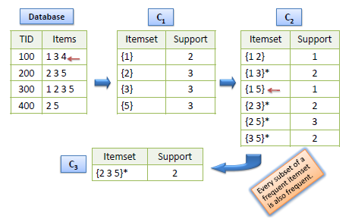
Apriori Algorithm

Slide 35
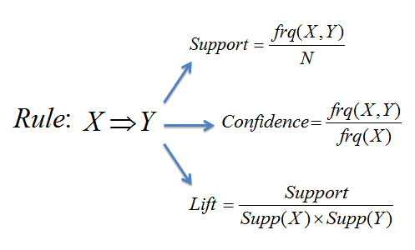
Association Rules - Constraints

Slide 36
Bananas Problem
Lift Addresses the Bananas problem
Bananas are a very commonly purchased item
If you look for rules using criteria, everything is associated with bananas
Lift down weights the value by the probability of both items, correcting for this phenomena

Slide 37
Characteristics of Apriori
Performance at Scale
Parallelizable?
Interpretability
Limitations
What type of data can it handle?
Can it learn effectively from high dimensional data?
Simplicity (ease of use \ configuration)

Slide 38
Characteristics of Apriori
Performance at Scale
Provided support threshold is relatively high, the rule length restricted, then efficient as only extends rules above support threshold.
Parallelizable?
Interpretability
Limitations
What type of data can it handle?
Can it learn effectively from high dimensional data?
Simplicity (ease of use \ configuration)

Slide 39
Characteristics of Apriori
Performance at Scale
Provided support threshold is relatively high, the rule length restricted, then efficient as only extends rules above support threshold.
Parallelizable?
Rules can be extended in parallel
Interpretability
Limitations
What type of data can it handle?
Can it learn effectively from high dimensional data?
Simplicity (ease of use \ configuration)

Slide 40
Characteristics of Apriori
Performance at Scale
Provided support threshold is relatively high, the rule length restricted, then efficient as only extends rules above support threshold.
Parallelizable?
Rules can be extended in parallel
Interpretability
Yes – a grouping of items commonly found together with accompanying frequency information
Limitations
What type of data can it handle?
Can it learn effectively from high dimensional data?
Simplicity (ease of use \ configuration)

Slide 41
Characteristics of Apriori
Performance at Scale
Provided support threshold is relatively high, the rule length restricted, then efficient as only extends rules above support threshold.
Parallelizable?
Rules can be extended in parallel
Interpretability
Yes – a grouping of items commonly found together with accompanying frequency information
Limitations
Ignores ordering of items. For that, use sequence mining.
What type of data can it handle?
Can it learn effectively from high dimensional data?
Simplicity (ease of use \ configuration)

Slide 42
Characteristics of Apriori
Performance at Scale
Provided support threshold is relatively high, the rule length restricted, then efficient as only extends rules above support threshold.
Parallelizable?
Rules can be extended in parallel
Interpretability
Yes – a grouping of items commonly found together with accompanying frequency information
Limitations
Ignores ordering of items. For that, use sequence mining.
What type of data can it handle?
Categorical items only
Can it learn effectively from high dimensional data?
Simplicity (ease of use \ configuration)

Slide 43
Characteristics of Apriori
Performance at Scale
Provided support threshold is relatively high, the rule length restricted, then efficient as only extends rules above support threshold.
Parallelizable?
Rules can be extended in parallel
Interpretability
Yes – a grouping of items commonly found together with accompanying frequency information
Limitations
Ignores ordering of items. For that, use sequence mining.
What type of data can it handle?
Categorical items only
Can it learn effectively from high dimensional data?
N/A. Inputs are sets of items, of varying length.
Simplicity (ease of use \ configuration)

Slide 44
Characteristics of Apriori
Performance at Scale
Provided support threshold is relatively high, the rule length restricted, then efficient as only extends rules above support threshold.
Parallelizable?
Rules can be extended in parallel
Interpretability
Yes – a grouping of items commonly found together with accompanying frequency information
Limitations
Ignores ordering of items. For that, use sequence mining.
What type of data can it handle?
Categorical items only
Can it learn effectively from high dimensional data?
N/A. Inputs are sets of items, of varying length.
Simplicity (ease of use \ configuration)
Pretty simple. Set threshold and go.
May need some experimentation to determine appropriate threshold, but if too low, take only most frequent rules

